Slide 1

BES165: Infrastructure
Nuke Energy NSG, HELP-2016
Postal, Telecom, Mass.Comm (YB)
Kelkar-PPP
Rail Budget CAP-2016
Urban Infra-Bills.
Paris Summit Clean Energy

Slide 2
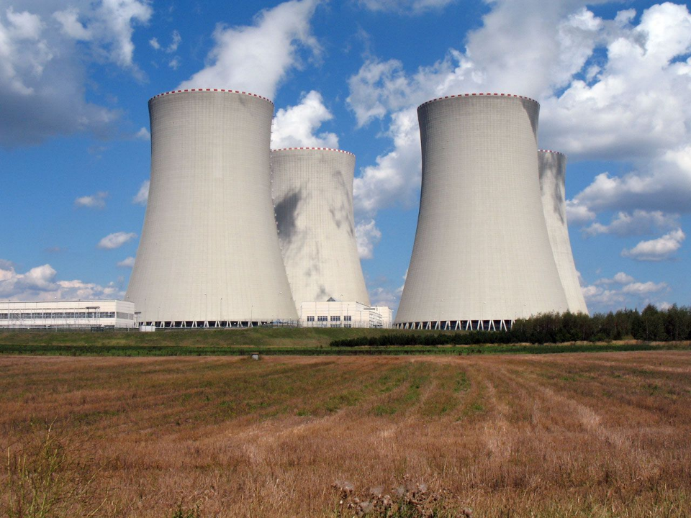
BES165 Infrastructure ► Energy infrastructure
Nuke Energy: Theory, Kakr, NSG
Thermal Energy: YB, UJALA, UDAY
Unconventional Gases
HELP-2016
Residential: Progressive tariff policy

Slide 3
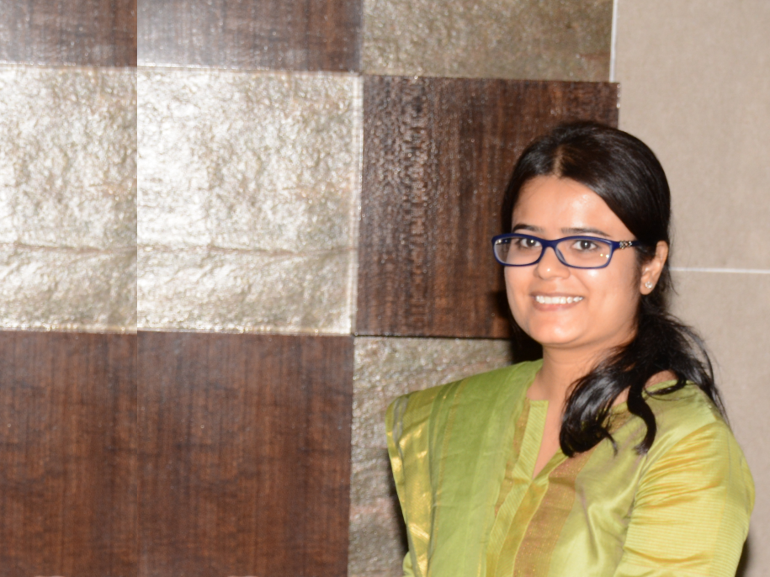
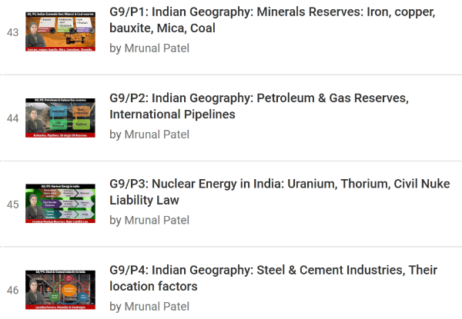
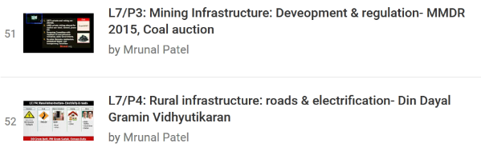
Self Study: Geography by Rajtanil► Mineral, Energy

Slide 4
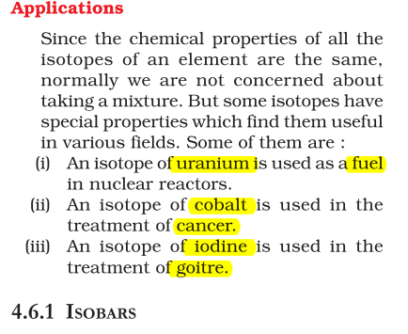
UPSC’s CAPF 2016
Isotope
Uranium:
Application
Treatment of goitre.
Cobalt:
Iodine:
Carbon:
Calculation of age of earth
Treatment of cancer.
Fuel in nuclear reactors.
NCERT Science Class.9 Ch4. Page.53

Slide 5
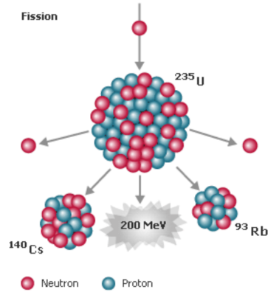
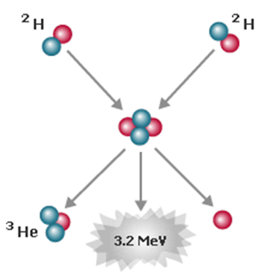
Nuke material, types of
2. Fissile Material
1. FUSION Material
Uranium-233| 235: yes
Uranium-238 (Natural)► Plutonium / Highly enriched Uranium (235|Bomb)
Fuse atoms► energy
Tritium, Deuterium
Notes:
3. Source material
Give addl. Atoms for fission/splitting
Helium, lithium, beryllium etc.

Slide 6
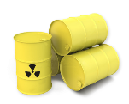
Types of Nuke Reactor: Fast Breeder
Input (Fissionable)
Natural Uranium-238
Thorium-232
Fast breeder Reactor
Coolant: Liquid Sodium Moderator: none
Output
Plutonium-239
Uranium-233
Aim: produce more fuel than it consumes
Experimental/ Research Reactor KAMINI
Kalpakkam Mini. Reactor (1996|30kW)
World’s only to use U-233 from Thorium
Purpose: nuke-radiography.

Slide 7
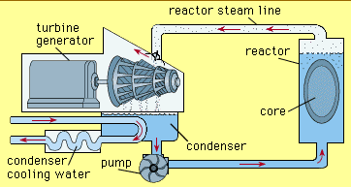
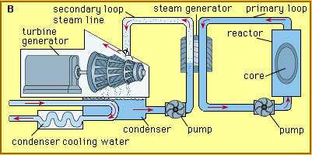
Nuke Reactors: types of
Boiling Water Reactor (BWR)
Same water as coolant, moderator, steam-source
Con: leakage can spread
Pressurized water (PWR)
Separate water as (coolant, moderator) vs. steam-source
If U-235 (enriched)► Heavy water as moderator PHWR e.g. Kakrapar
If Thorium fuel► Advanced Heavy Water (AHWR), BARC

Slide 8
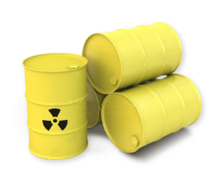
1992: Kakrapar, Tapi Surat District
Ukai Dam ‘72
Pipe carrying heavy water leaked
2016, March
IAEA Danger classification
1-3: Incident
Chernobyl ’86 (L7)
4-7: Accident
e.g. Kakrapar
Fukushima’11 (L7)
Notes:
Then Pripyat river, then in USSR and now in Ukrain.
It is one of only three rivers in peninsular India that run from east to west - the others being the Narmada River and the Mahi River. (Kadana)
Richter scale is
not linear. This means that an earthquake of magnitude 6 does not have one and
half times the destructive energy of an earthquake of magnitude 4. In fact, an
increase of 2 in magnitude means 1000 times more destructive energy. For
example, an earthquake of magnitude 6 has thousand times more destructive
energy than an earthquake of magnitude 4.
The Modified Mercalli Intensity Scale. The effect of an earthquake on the Earth's surface is called the intensity. The intensity scale consists of a series of certain key responses such as people awakening, movement of furniture, damage to chimneys, and finally - total destruction.

Slide 9
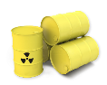
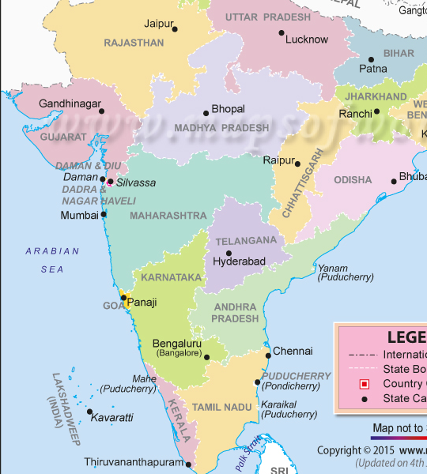

Nuclear plants in India (list not exhaustive)
Narora: PHWR
Rawatbhata: PHWR
Kakrapar: PHWR
TARAPUR:BWR
Kaiga: PHWR
Kalpakkam FBR
Kudankulam:
PWR (VVER)
water cooled, water moderated (Russian)

Slide 10
Nuclear plants (proposed) List not exhaustive
Mithi-Virdi, Bhavngr
Westinghouse-USA
Haripur, W.Bengal
VVER, Russia
Jaitapur
Areva, France
Kovvada, Andhra
GE-Hitachi
Bigger list you can get wiki

Slide 11
BES165 Infra► Energy ► Nuclear energy
Types of
Nuke Material
Nuke Reactor
Theory Revision
Kakrapar “Incident”
NSG Membership

Slide 12
India’s nuke program: Stages of-
Stage-I
Stage-II
Stage-III
PHWR (U-235)
FBR
Thorium Based (AHWR)
1968: NPT, India did not sign
2008: India-USA 123
Thorium►U-233
NSG Waiver (2008)
Though you’ve not signed NPT, we’ll supply fuel & tech for your civil nuke program
France, Mongolia, Kazakhstan, Canada…

Slide 13
4 export control groups: Chronology
Nuke Supplier Group ‘74 (48 members)
MTCR’ 87 (34 +Ind=35 members)
Wassenaar’96 (41 members)
Australia Group’85 (42 members)
Missile & drones
500kg payload over 300km/>
Town: Netherland
Conventional arms, dual-use goods/tech
Notes:
Aus.Gr.’85
Chemical, Biological weapons
Wassenaar Agreement’96

Slide 14
2016: Became member of MTCR + SCO
Nuke Supplier Group
Missile Tech Ctrl Regime
China+7 other opposed India: NPT not signed, we can give fuel/tech. but not membership
USA, UK, France, Germany, Russia, Canada and Japan. supported
Decision on consensus, earlier Italy opposed on Marines/Enrica Lexie, but pacified.
China not member, we can oppose in future.
500kg payload for 300kms/>
Buy predator UAV / tech. | Sell Brahmos missile / tech.
Notes:
China tried btu accused of selling missle tech. to north korea.
http://indianexpress.com/article/india/india-news-india/no-entry-in-nsg-india-blames-one-country-china-others-said-no-too-2874377/

Slide 15
BES165 Infrastructure ► Energy infrastructure
Nuke Energy: Theory, Kakr, NSG
Thermal Energy: YB, UJALA, UDAY
Unconventional Gases
HELP-2016
Residential: Progressive tariff policy

Slide 16
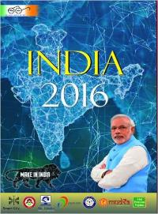
“DESHI” (=thermal) Electricity in India
BEFORE AAZADI
AFTER AAZADI
1897
Electricity in Darjeeling
1902
Hydropower station at Sivasamudram in Karnataka
FYP
State Electricity boards
2003
Electricity Act
Central Electricity Authority
Pre independence
Confined to urban area
Dominated by private sector
Just like banks
Polity
State can impose tax on electricity sale. But not if used by Centre /Railways (Art. 287)
Rural Electrification- PRI –function

Slide 17

Power ministry organization (Yearbook)
2 Joint Ventures
Satluj Jal Vidyut- Nathpa Jharki project @HP; cost-75:25
Tehri Hydro- Uttarakhand
3 Statutory
Damodar Valley Corporation (DVC)
Bhakra-Beas Management Board (BBMB)
Bureau of Energy Efficiency (BEE)
NBFC- PSU
Rural Electrification
4 PSUs
NTPC- thermal
NHPC - Hydro
Powergrid
NE
Power trading Corp.
Power Finance Corp.► UMPP, 4k MW, Sasan in Madhya Pradesh, Mundra in Gujarat, Krishnapatnam in Andhra Pradesh and Tilaiya in Jharkhand
Oil/gas PSU: Page 314
COAL PSU: Page 320

Slide 18

Electricity: Modi Schemes (Chronology)
Deendayal Upadhyaya GramJyoti (DDUGJY) Budget'14
100% Rural electricity by 1st May 2018 (REF: L7 series)
Integrated Power Development Scheme (IPDS) Dec'14
strengthening sub-transmission and distribution system
Ujwal DISCOM Assurance Yojana (Uday) ‘15, Nov.
Discom Debt problem
National LED Program, 2015-Jan
INDC: ⇩emission Intensity of GDP by 33-35% (2005 vs 2030)
Street light; Domestic light ► Make in India LED

Slide 19
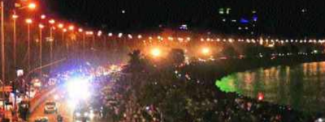
Power Ministry►LED program
EESL is JV between NTPC Limited, PFC, REC and POWERGRID
Energy Efficiency Services Ltd
DELP (UJALA)
SLNP (Streetlight)
Street Lighting National Programme (SLNP)
Domestic Efficient Lighting Programme (DELP)
Replace with LED without taking $$ from ULB
Cheaper LED via DISCOM
Unnat Jyoti by Affordable LEDs for All (77cr. LED)
Notes:
આત;લ કરોડ બચશે વગેરે માં મતલબ નથી.

Slide 20
Bulb theory (!)
Heating produces light, sun also doing same
Gas discharge lamps
Tungsten: DESHI /filament /incandescent
Tungsten filament : high melting point
Mercury► UV► florescence coating►visible
Florescent tube light | CFL: Compact Florescent lamp
Sodium vapor lamp: low press (yellow),
Minamata convention on Mercury (Japan, UNEP, 2013)
Argon- inert gas because oxygen will burn filament
Halogen Lamp: Tungsten + Iodine and Bromine ; television/film shooting
Neon: Florescent bulbs for advertisement, Botanical garden, greenhouses
Sodium high press (white-ish); mercury vapor (White)
Atom excited by photons
Halogens: Fluorine, chlorine, bromine, iodine and astatine
Noble/Inert gas: helium, neon, argon, krypton, xenon and radon.

Slide 21
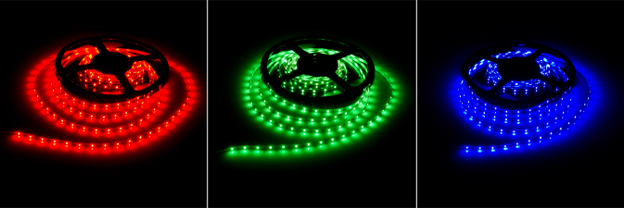

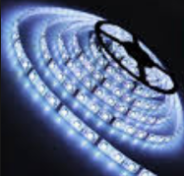
LED: Light emitting diodes
Anode(+) & Cathode(-)
Electro-luminescene
Color depends on semiconductor used
~22 years back they invented blue LED
RGB=WHITE led

Slide 22
Electricity: Modi Schemes (Chronological)
Deendayal Upadhyaya GramJyoti (DDUGJY) Budget'14
100% Rural electricity by 1st May 2018 (REF: L7 series)
Integrated Power Development Scheme (IPDS) Dec'14
strengthening sub-transmission and distribution system
Ujwal DISCOM Assurance Yojana (Uday) ‘15, Nov.
Discom Debt problem
National LED Program, 2015-Jan
INDC: ⇩emission Intensity of GDP by 33-35% (2005 vs 2030)
Street light; Domestic light ► Make in India LED

Slide 23
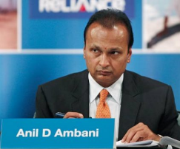
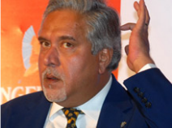

DISCOM Debt: Avg cost of supply > Avg. Tariff
Complex list
high cost of processing info.
Customer doesn’t respond to tariff change quickly = “Salience”.
Survey: keep only 2-3 categories.
State electricity regulation board decide tariff under Electricity Act 2003
Sample unit price
Dryland farmer: Rs.0
Wetland farmer: Rs.0.50 Paisa
Cottage industry: Rs. 3.75
Pisciculture: Rs.4.6
…..
Commercial: Rs.5 to 9
Power plant
Power Exchange
Avg cost of supply (high)
DEBT
Avg Tariff (low)
DISCOM
Customers
Notes:
Discoms companies act as intermediaries between generators and retail consumers
They buy from generators/wholesale market (power exchange).
Sell it to retail customers. (@markup price over cost)
But in many states, Average tariff (AT) Lower than Avg. Cost of Supply (ACS)
Hence Discoms- debt overhang, losses.

Slide 24
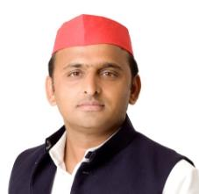
Open Access policy?
But if bought from Power-exchange, states demand addl. Surcharge
Power plant
Power Exchange
Customer with 1MW+ load can directly buy
Single National market, price discovery through daily supply-demand. Congestion solved.
Avg cost of supply (high)
DEBT
Avg Tariff (low)
DISCOM
Customers
Notes:
Discoms companies act as intermediaries between generators and retail consumers
They buy from generators/wholesale market (power exchange).
Sell it to retail customers. (@markup price over cost)
But in many states, Average tariff (AT) Lower than Avg. Cost of Supply (ACS)
Hence Discoms- debt overhang, losses.

Slide 25

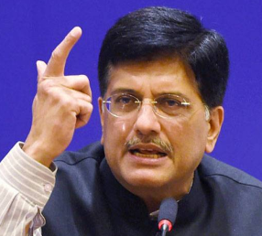

Ujwal DISCOM Assurance Yojana (UDAY)
UDAY is optional but If a state implements, it’ll get addl. /priority Funding in DD Gram Jyoti, IPDs, and other schemes.
COOPERATIVE FEDERALISM
50% 2015
25% 2016
75% Total
States to takeover debt (optional)
Issue Non-SLR bonds
Debt on 30/09/15
Notes:
Remaining 25% : converted into bonds/loan

Slide 26
BES165 Infrastructure ► Energy infrastructure
Nuke Energy: Theory, Kakr, NSG
Thermal Energy: YB, UJALA, UDAY
Unconventional Gases
HELP-2016
Residential: Progressive tariff policy

Slide 27
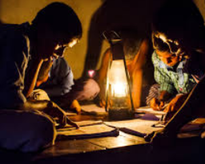
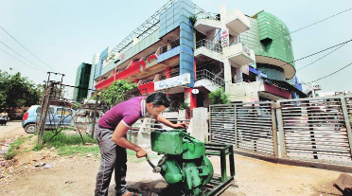
Electricity scene in India
Supply side: coal; demand side: Discom debt problem
Actual production
Plant load factor (~60%)
Max. Capacity
5 Cr. House without electricity
47% firms use diesel generators (72GW)
Notes:
5 crore households without access to electricity
Plant load factor: measure of the output of a power plant compared to the maximum output it could produce. India: 60-65% (coal/gas supply issues, discom supply issues)
SDG: Renewable energy targets revised from 32 GW to 175 GW by 2022 (earlier 32GW)

Slide 28
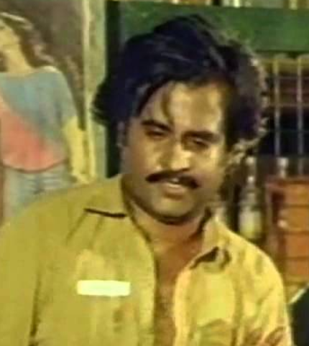

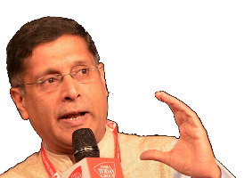
Survey solution
Progressive electricity Tariff
Cross Subsidization
Poor Household
Rich Household
Rail Freight to passenger cross subsidization = bad
But here not bad (bcoz households not firms)
Tried, Tested and Successful in Bangladesh, Sri Lanka, South Korea, Vietnam and Brazil.
Est. 14k+ crores will be saved in subsidies.
Notes:
Give cheap electricity to poors
Charge higher electricity bill on rich households

Slide 29
From survey
Economic Survey 2015-16 recommends which of the following reforms in Power sector?
Progressivity of electricity tariffs in the domestic category
Cross subsidization of electricity tariffs from industrial to domestic category.
Both A and B
Neither A nor B

Slide 30

Power sector reforms
Survey
Higher tariff = make in India hurt.
simple, transparent: (less End-use charges), Progressive rate-setting.
quality-adjusted (disruption, voltage fluctuation, outages)
One market for power sector, Cheap electricity for industry = Catalyst for make in India.
Need cooperative federalism though.

Slide 31
Power sector reforms
Mains
Power sector reforms as “Crucible” for competitive and cooperative federalism.

Slide 32
BES165 Infrastructure ► Energy infrastructure
Nuke Energy: Theory, Kakr, NSG
Thermal Energy: YB, UJALA, UDAY
Unconventional Gases
HELP-2016
Residential: Progressive tariff policy

Slide 33
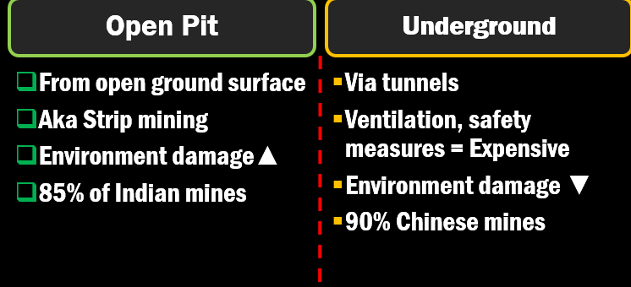
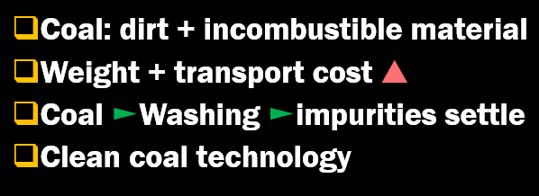
Self study: Coal and Minerals (L7)
Type | Note | Carbon
Peat | Highest moisture = smoke. Most inferior. | 40%
Lignite Brown coal | TN (Neyveli), Gujarat, Rajasthan | 40-60
Bituminous Black-Coal | Released Bitumen liquid Upon heating Mfg. coking coal, gas coal, steam coal Chattisgarh, Jharkhand, WB, MP, Odisha | 60-80
Anthracite hard coal | Short blue flame Lowest moisture | 80-90

Slide 34
Types of Gases
Conventional
Small in volume but easy to drill
Ex. Natural gas
medium to high permeability reservoirs
The reservoirs have natural fractures
Unconventional
High volume but difficult to drill. Hydraulic fracturing req.
Ex. Tight gas sands, coal bed methane, shale gas, Syngas
Reservoirs are impermeable
No natural fractures

Slide 35
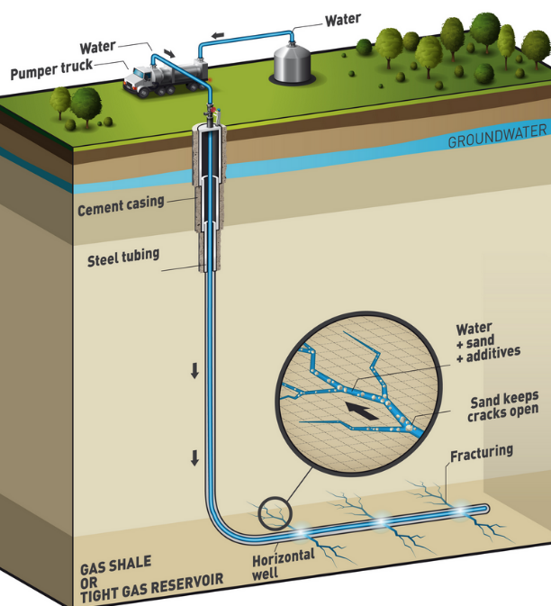
India trial since 2010
Not priority since
Guar Gum (viscosity agent) price affects
Large area
Lot of water
Hydraulic fracturing
Shale gas- locked in rock formation, color-odour no; lighter than air

Slide 36
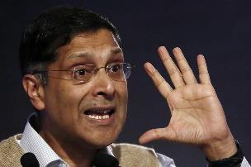
Shale gas: DG hydrocarbon
Geographically
Cambay, Gondwana, Krishna-Godawari, Cauvery.
ONGC+OIL blocks
Gujarat (28)
Andhra (10),
Assam (6)
Rajasthan (1)
Arunachal (1)
Tamil Nadu (9)
but commercial production yet to begin

Slide 37
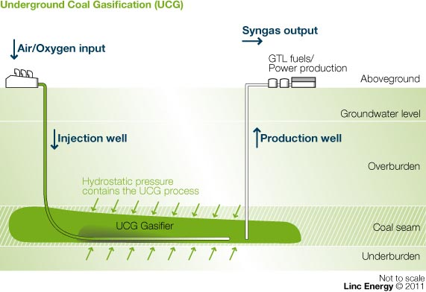
Syngas
Syngas
Water, Oxygen
Gasification agent
Syngas: fuel; hydrogen & fertilizers mfg.
Manual mining of coal…..X
By products like sulphur, mercury, arsenic, tar, ash particulates….remain underground.
Less water
Deep, unrecoverable coal reserve
Notes:
Technique- very deep and unrecoverable coal reserve
Exploration and gasification of coal simultaneously
similar technique = outside the mine
pressure at the depth = the surface gasification site
2 wells underground coal seam
one well- inject air/oxygen into coal seam
The oxygen synthesis with the gas ► syngas
Second well extract the syngas

Slide 38
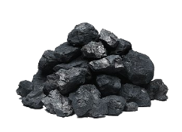
Coal bed methane
Unconventional Gas
CBM – methane in coal seams
1997: policy. Separate licensing for coal, and CBM (Methane blast)
1st started: Dhanbad
Essar: Raniganj; Reliance: Sohagpur, MP
Ranga Gas formula applies
Latest-survey: CIL started in its own coalmines

Slide 39
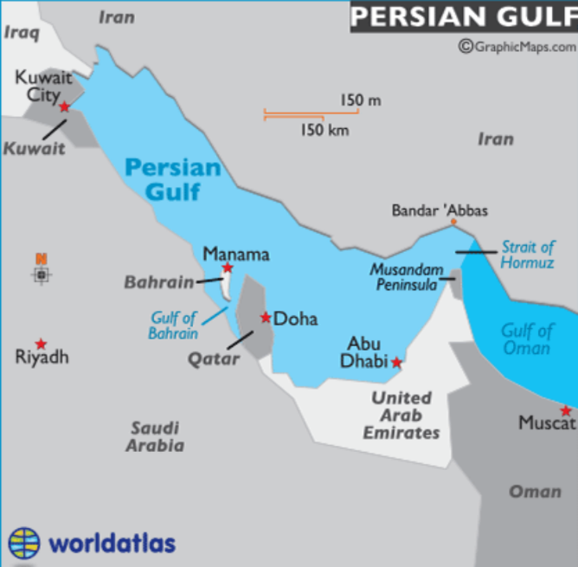
Farzad B Gas reserve
Farzad B Gas reserve, ONGC-V + Irani PSU to develop
1.Manama declaration-2016 signed between ___ for ___ purpose?
3.This will open in Arabian sea or Red sea?
4.Modi got highest civilian award of ___ country? (Saudi, Afghanistan both)
5.Cheraman Juma Masjid- the Oldest mosque of India, built under Chera empire in Kerala state?

Slide 40
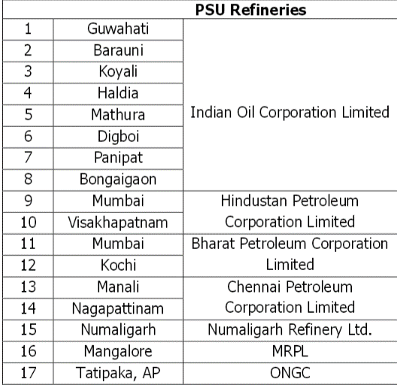
How many refineries in India (may be outdated)
17 PSU
3 Private
Reliance
Jamnagar, GJ
Yanam, Puducherry
Essar
Vadinar, GJ
Cairn
Amalpuram, AP
2 JV
Bina (MP): Bharat + Oman
Bathinda: HPCL + Mittal

Slide 41
BES165 Infrastructure ► Energy infrastructure
Nuke Energy: Theory, Kakr, NSG
Thermal Energy: YB, UJALA, UDAY
Unconventional Gases
HELP-2016
Residential: Progressive tariff policy

Slide 42
Hydrocarbon Exploration & Licensing Policy (HELP)-2016
Timeline
Constitution: Union owns all Hydrocarbon resources
1997: New exploration license policy (NELP); 10th rounds of auction
2016: HELP policy Petroleum ministry
Features of HELP license
Uniform single license: for conventional & unconventional oil/gas resources: CBM, shale gas/oil, tight gas and gas hydrates.
Open Acreage: no wait for “auction-rounds”, yourself send expression of interest- govt will invite bids and allot.

Slide 43
Hydrocarbon Exploration & Licensing Policy (HELP)-2016
BEFORE
Profit sharing after cost recovery (gold plating). Kelkar favored.
Production linked payment (underproduction when intl. market falls)
Reliance KG6, CAG
AFTER (RSC)
Revenue sharing from gross sale of oil, gas
C.Rangarajan favored.

Slide 44
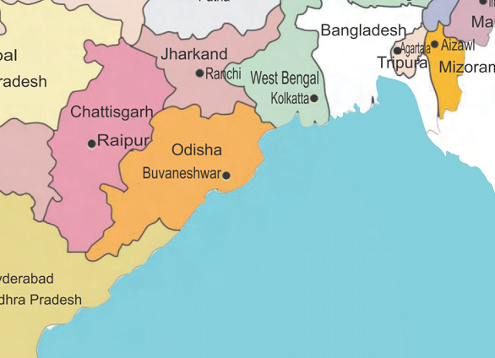
HELP: “Graded” royalty ∝ 1/(risk & cost)
Marketing freedom
No compulsion to sell to thermal/ fertilizer cos.
Land >> Shallow >> Deepwater >> ultra deep

Slide 45
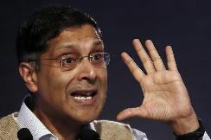
Reforms in Petro-gas sector
Survey
Petro / gas product don’t exempt from GST| Atleast not directly in Constitution.
Cess ►all India gas pipeline; producing states►consuming states.
Max. 10 LPG cylinders to each household.
Imported LNG gas- power sector no custom duty. Don’t give such exemptions.

Slide 46
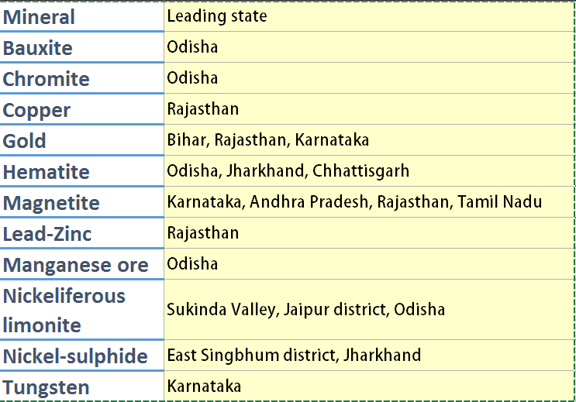
IYB Ch. 16 Industries► Minerals► Metallic
Atleast memorize
which ones are metailic and which ones are non-metallic
Your states’ mineral wealth

Slide 47
IYB Ch. 16 Industries► Minerals► Non-Metallic
Atleast memorize
which ones are metailic and which ones are non-metallic
Your states’ mineral wealth

Slide 48
Mining production improved;
District Mineral Foundation (DMF):
Pradhan Mantri Khanij Kshetra Kalyan Yojna (PMKKKY):
Under MMDR act
6000 crore per annum is to be spent on welfare schemes in districts adversely affected by mining activities.
Under Ministry of Mines
States decide membership composition
Miners to pay 10%-30% of royalty to DMF►PMKKKY

Slide 49
8 Core industries in IIP: self study “L5”
Coal
Electricity
Crude oil
natural gas
Refinery products
Fertilizers
Steel
Cement
Positive
Faster env.clearance, coal auction, coal bill
Mostly thermal, so if coal +ve yet Electricity moderate
DISCOM Debt. Problem (More INFRA lecture)
Negative- fall in ONGC, OIL wells
Credit flow reduced but that’s cause of subsidy reforms led to less credit need
Same as crude
moderate
Positive but survey wants overhaul
More in Agri. lecture
Negative bcoz China demand down► cheaper steel imports
Moderate
Domestic steel industry suffering
But don’t raise tariff barriers else downstream will suffer
Overall IIP Recovery
Notes:
IIP = provides quick estimates of the performance of key industrial sectors

Slide 50
235 operational + 63 under construction = 298 CPSEs
Top-5 profit makers (2014-15)
ONGC Ltd
Coal India Ltd
NTPC Ltd (Thermal)
NMDC (Mineral)
Power Finance Corporation Ltd
Top-5 Loss making
Bharat Sanchar Nigam Ltd
Air India Ltd
Mahanagar Telephone Nigam Ltd
Hindustan Photo Films Manufacturing Company
Mangalore Refinery
How do CPSE help public exchequer?
dividend payment, interest on government loans
payment of taxes and duties viz. corporate tax, custom duty, excise duty, dividend tax, sales tax and service tax.

Slide 51
BES165 Infrastructure ► Energy infrastructure
Nuke Energy: Theory, Kakr, NSG
Thermal Energy: YB, UJALA, UDAY
Unconventional Gases
HELP-2016
Residential: Progressive tariff policy

Slide 52
BES165: Infrastructure
Nuke Energy NSG, HELP-2016
Postal, Telecom, Mass.Comm (YB)
Kelkar-PPP
Rail Budget CAP-2016
Urban Infra-Bills.
Paris Summit Clean Energy

